Slide 1
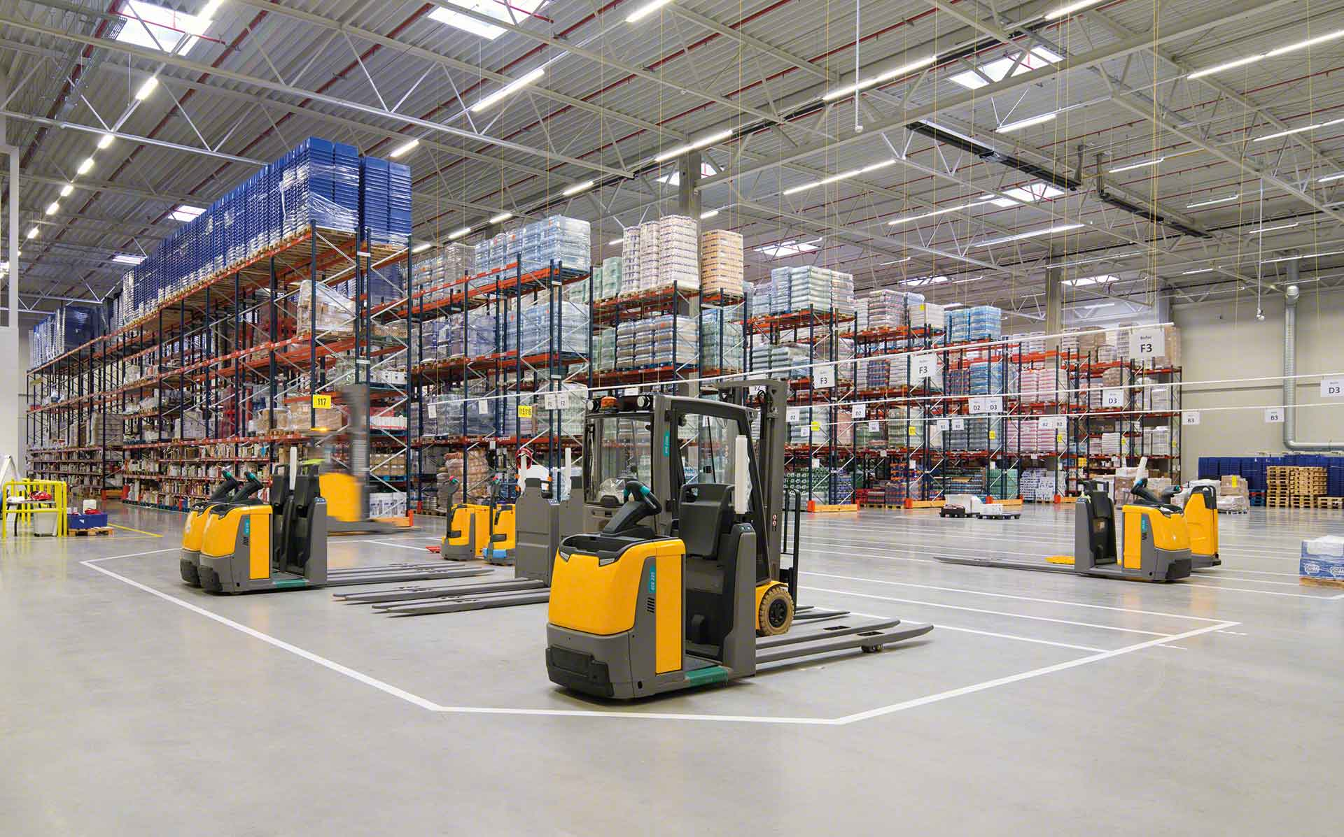

Material Handling KPI
Semana 3 septiembre 2022

Slide 2
Movements September
Monthly movements
4564
Monthly movements
4122
User | Sum of CYCLE COUNTS | Sum of MAT HANDLE | Sum of cc MH
judelato | 3 | 1426 | 1429
erojas | 3 | 1059 | 1062
jtobias | 23 | 885 | 908
jodelacr | 42 | 836 | 878
amiranda | 0 | 358 | 358
Grand Total | 71 | 4564 | 4635
User | Sum of CYCLE COUNTS | Sum of MAT HANDLE | Sum of cc MH
amiranda | 2 | 1068 | 1070
erojas | 1 | 996 | 997
judelato | 2 | 925 | 927
jtobias | 10 | 567 | 577
jodelacr | 30 | 566 | 596
Grand Total | 45 | 4122 | 4167

Slide 3
Cycle counts
Adjustments difference
$3,245.87
Adjustments difference
$4,461.62
Row Labels | Sum of COST | Count of PART
jtobias | $2,193.51 | 24
jodelacr | $1,242.81 | 43
judelato | $30.72 | 2
erojas | -$221.17 | 3
Grand Total | $3,245.87 | 72
Row Labels | Sum of COST | Count of PART
jtobias | $4,858.66 | 7
judelato | $434.04 | 2
erojas | -$14.86 | 1
jodelacr | -$816.22 | 24
Grand Total | $4,461.62 | 34

Slide 4
Labor intensive
Class not slotted count
12
Labor Intensive
34

Slide 5
rESTOCK
Part Numbers stocked
1276
Part Numbers stocked
1171

Slide 6
Empty locations
Row Labels | Sum of Total de espacios disponibles
Jul | 316
Aug | 1586
Sep | 623
Oct | 2338
Grand Total | 4863
Monthly empty locations
2338

Slide 7
Consolidation
Total Month consolidations
87 part numbers
Total week consolidations
29
part numbers
Empty locations
90

